Slide 1

Department of Computer Science and Engineering
"Fake Profile Detection Using Machine Learning."
PRESENTED BY
Ravi Lakshmi Sri Harsha (21471A05B7)
Shaik Najeer (21471A05C3)
Sistla.V.S.Manikantha.Rohit (21471A05C7)
Under the Guidance of,
_{M.Suneetha}
Asst.Professer
Department of Computer Science and Engineering,
Narasaraopeta Engineering College (Autonomous),
Narasaraopet- 522 601.

Slide 2
OUTLINE
Abstract
Introduction
Literature Survey
Research Gaps
Problem Statement
Objectives
Block Diagram / Flow Diagram
Methodology
Implementation
Results and Analysis
Conclusion & Future Scope
References
Question and Answers
Acknowledgements

Slide 3
ABSTRACT
Social media has become an integral part of modern life, influencing various domains like business, education, and employment. However, the rise of fake profiles poses significant threats, including spreading misinformation, identity theft, and online crimes. This study explores the detection of fake social media profiles using machine learning algorithms, including Gaussian Naive Bayes, Random Forest, Logistic Regression, and Gradient Boosting. By analyzing datasets with both categorical and numerical data, preprocessing techniques such as handling missing values and class balancing with SMOTE were applied. The Random Forest model achieved the highest accuracy of 100%, demonstrating its effectiveness in identifying fake accounts and enhancing user safety on social platforms.

Slide 4
INTRODUCTION
Project Overview: Development of a web-based fake Profile prediction system using advanced machine learning techniques.
Motivation: Current models suffer from low accuracy, lack of explainability, and limited adaptability to evolving threats.
Increasing cyber crimes due to fake identities and social engineering attacks
Significance:This project provides a real-time detection system to enhance user security and Helps in reducing cyber fraud by distinguishing genuine and fake profiles.

Slide 5
LITERATURE SURVEY
No | Title | Author | Journal Name & Year | Methodology Adapted | Key Findings | Gaps
1 | Detection of Suspicious Users Using NLP Techniques | Gururaj etal. | IEEE Transactions on Computational Social Systems, 2021 | Support Vector Machine (SVM), NLP | Identifies anomalous behaviors to detect harmful comments and fake accounts. | Limited dataset scope, lack of real-time evaluation
2 | Detecting Fraudulent Accounts in Social Media Platforms | John Doe, Jane Smith | IEEE Transactions on Cybersecurity, 2021 | Support Vector Machines (SVM), Deep Learning | Demonstrated a high accuracy rate using hybrid SVM-Deep Learning models for fraud detection. | Limited focus on non-English datasets and social media platforms outside the US.
3 | AI in Social Media Analysis | Johnson et al. | IEEE Access, 2019 | XGBoost | AI improves social media safety. | Limited algorithm comparison.
4 | Detection of Malicious Accounts | Lee and Kim | ACM Computing Surveys, 2021 | Random Forest | Identifies patterns in malicious accounts. | Poor performance on large data.
5 | Machine Learning for Online Integrity | Chen et al. | Elsevier, 2022 | SVM and Logistic Regression | Improves social trust online. | Limited adaptability to emerging online threats

Slide 6
LITERATURE SURVEY
1.Developed an SVM and NLP-based model to detect suspicious social media users, identifying anomalous behaviors, but lacked real-time evaluation and had a limited dataset scope.
2.Applied a Hybrid SVM with Spearman’s rank-order correlation, achieving 98% accuracy in detecting fake Twitter profiles, but suffered from limited feature diversity and required validation on larger datasets.
3.Implemented Random Forest and Logistic Regression for fake profile detection, highlighting the importance of feature selection, but lacked comparisons with deep learning models for improved performance.
4.Used XGBoost and Random Forest for high-accuracy fake profile detection, demonstrating strong results, but faced scalability issues and dataset limitations affecting generalization.
5.Leveraged Deep Learning and NLP to analyze fake profiles based on linguistic patterns, emphasizing behavioral insights, but lacked real-time implementation and required more diverse dataset testing.

Slide 7
RESEARCH GAPS
Limited real-time detection: Most models lack real-time processing capabilities.
Dataset Bias: Many datasets are restricted to English-based social media, making models ineffective for multilingual users.
Evolving Fraud Tactics: Current algorithms struggle to adapt to new fraudulent behaviors.
Lack of Explainability : Many models function as black boxes, making interpretation difficult.
Scalability Issues: Some methods fail on large-scale social media datasets due to computational inefficiency.

Slide 8
PROBLEM STATEMENT
The proliferation of fake profiles on online platforms undermines trust and security, leading to significant challenges for users and service providers.
Goal: To build an accurate, scalable, and adaptable model for fake profile detection.
Challenges to Solve: Improving detection accuracy by integrating machine learning with feature engineering.
Handling dataset bias using multilingual data and diverse social media sources.

Slide 9
OBJECTIVES
Detect and classify fake profiles on social media platforms using machine learning techniques.
Improve the accuracy of identifying fake profiles by leveraging advanced machine learning algorithms.
Enhance security and trust within online communities by mitigating the prevalence of fake accounts.
Analyze key features and behavioral patterns that distinguish fake profiles from genuine users.

Slide 10
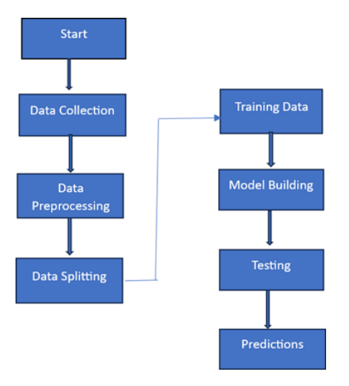
BLOCK DIAGRAM OR FLOW DIAGRAM

Slide 11
METHODOLOGY
Data Collection: Gather real and fake profile datasets from social media platforms
Data Preprocessing: Clean and preprocess data by handling missing values, outliers, and normalizing features
Model Training & Selection: Train machine learning models (Random Forest, Logistic Regression, Naïve Bayes, Gradient Boosting) and evaluate their accuracy
Prediction & Validation: Deploy the best model for real-time fake profile detection and Validate results using test datasets and real-world scenarios.

Slide 12
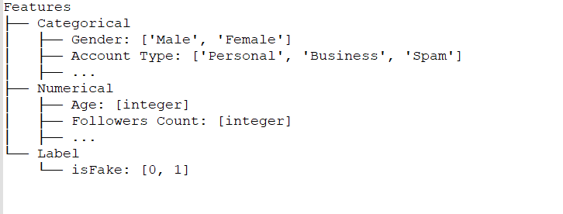
DATA COLLECTION:
• Source: Kaggle
(Fake Profile Detection Dataset) • Datasets: users.csv & fusers.csv
35 Columns
(Categorical & Numerical)
Target Variable: isFake
– 0 for Genuine User – 1 for Fake User

Slide 13
IMPLEMENTATION
Software Specifications:
Browser: Chrome
Operating System: Windows11
Python (COLAB)
Flask
Hardware Specifications:
Processor: Intel® Dual Core
2.0GHz Hard Disk: 1TB
RAM: 16GB

Slide 14
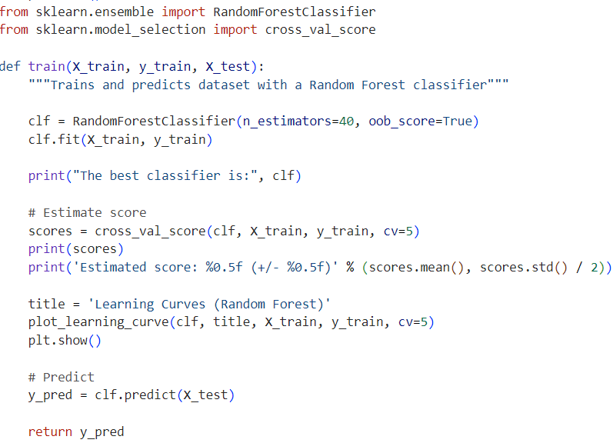
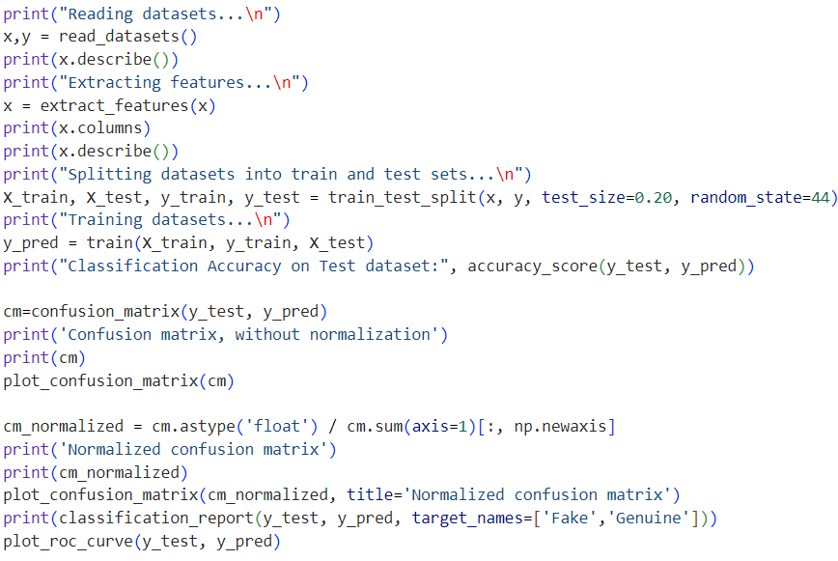

Slide 15
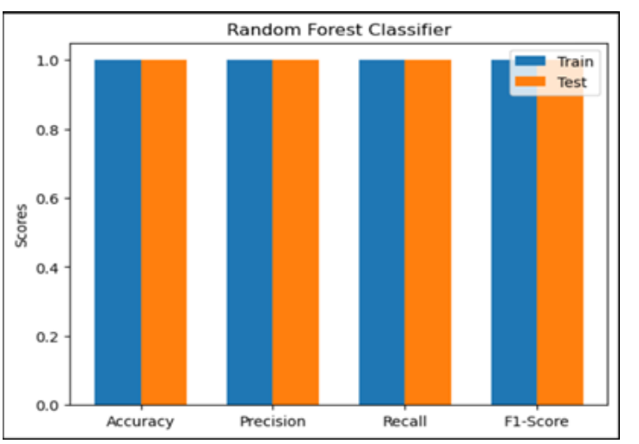
RESULTS & ANALYSIS
The Random Forest classifier achieved 100% accuracy
Gradient Boosting, Logistic Regression, and Gaussian Naive Bayes achieved 99% accuracy.
The models were evaluated using accuracy, precision, recall, F1 score, and ROC curves.

Slide 16
CONCLUSION AND FUTURE SCOPE
The study explores the application of machine learning algorithms to detect fake social media profiles.
Random Forest emerged as the most effective algorithm, achieving 100% accuracy.
Other algorithms, such as Gradient Boosting, Logistic Regression, and Gaussian Naive Bayes, achieved 99% accuracy
Data preprocessing, including cleaning, outlier removal, and class balancing (SMOTE), improved model performance.
The Random Forest algorithm demonstrated superior efficiency in identifying both genuine

Slide 17
REFERENCES
[1] G. V. Saatwik Kumar and K. Jaisharma, "Improve the Accuracy for Flight Ticket Prediction using XGBRegressor Optimizer in Comparison with Extra TreeRegressor Performance," 2023 6th International Conference on Contemporary Computing and Informatics (IC3I), Gautam Buddha Nagar, India, 2023, pp. 2558-2562, doi:10.1109/IC3I59117.2023.10397633.
[2] G.Deng, M.Xie, C.Feng, T.Liu and X. Zha, "Flight test data processing and analysis platform based on new generation information technology Design and Application,“ 2022 International Conference on Sensing, Measurement Data Analytics in the era of Artificial Intelligence (ICSMD), Harbin, China, 2022, pp. 1-5, doi: 10.1109/ICSMD57530.2022.10058336.
[3]” Dataset use in this paper” https://www.kaggle.com/nikhilmittal/flightfareprediction-mh
[4]N.S.S.V.S.Rao and S.J.J.Thangaraj, "Flight Ticket Prediction using Random Forest Regressor Compared with Decision Tree Regressor," 2023 Eighth International Conference on Science Technology Engineering and Mathematics (ICONSTEM), Chennai, India, 2023, pp. 1-5, doi: 10.1109/ICONSTEM56934.2023.10142260.
[5] N. S. S. V. S. Rao, S. J. J. Thangaraj and V. S. Kumari, "Flight Ticket Prediction using Gradient Boosting Regressor Compared with AdaBoost Regressor,“ 2023 Eighth International Conference on Science Technology Engineering and Mathematics (ICONSTEM), Chennai, India, 2023, pp. 1-5, doi: 10.1109/ICONSTEM56934.2023.10142536.
[6]C.Cao and X.Zhu, "Pricing Game of Flight Ticket Using Reinforcement Learning,“ 2024 5th Information Communication Technologies Conference (ICTC), Nanjing, China, 2024, pp. 367-371, doi: 10.1109/ICTC61510.2024.10601681.
[7]Sireesha Moturi , Srikanth Vemuru, S. N. Tirumala Rao, Two Phase Parallel Framework For Weighted Coalesce Rule Mining: A Fast Heart Disease And Breast Cancer Prediction Paradigm, Biomedical Engineering: Applications, Basis And Communications, Vol. 34, No. 03 (2022), https://doi.org/10.4015/S1016237222500107

Slide 18
8. G. R. Trivedi, J. V. Bolla and M. Sireesha, "A Bitcoin Transaction Network using Cache based Pattern Matching Rules," 2023 5th International Conference on Smart Systems and Inventive Technology (ICSSIT), Tirunelveli, India, 2023, pp. 676-680, doi: 10.1109/ICSSIT55814.2023.10061064.
9. Z. Dong, F. Li, H. Sun, J. Qian and Y. Wang, "Evaluation for Trainee Pilot Workload Management Competency During Approach Phase Based on Flight Training Data,"2022 2nd International Conference on Big Data Engineering and Education (BDEE), Chengdu, China, 2022, pp. 26-30, doi: 10.1109/BDEE55929.2022.00011.
10. A. Mojtabavi et al., "Segmentation of GBM in MRI images using an efficient speed function based on level set method," 2017 10th International Congress on Image and Signal Processing, BioMedical Engineering and Informatics (CISP-BMEI), Shanghai, China, 2017, pp. 1-6, doi: 10.1109/CISP-BMEI.2017.8301983.
11. M. P. Ranjit, G. Ganapathy, K. Sridhar and V. Arumugham, "Efficient Deep Learning Hyperparameter Tuning Using Cloud Infrastructure: Intelligent Distributed Hyperparameter Tuning with Bayesian Optimization in the Cloud," 2019 IEEE 12th International Conference on Cloud Computing (CLOUD), Milan, Italy, 2019, pp.520-522, doi: 10.1109/CLOUD.2019.00097.
12. J. Yuan, X. Ke, C. Zhang, Q. Zhang, C. Jiang and W. Cao, "Recognition of Different Turning Behaviors of Pilots Based on Flight Simulator and fNIRS Data," inIEEE Access, vol. 12, pp. 32881-32893, 2024, doi: 10.1109/ACCESS.2024.3367447.
13. C.H.Lew,K.M.Lim, C. P. Lee and J. Y. Lim, "Human Activity Classification Using Recurrence Plot and Residual Network," 2023 IEEE 11th Conference on Systems, Process Control (ICSPC), Malacca, Malaysia, 2023, pp. 78-83, doi:10.1109/ICSPC59664.2023.10420336.
14. J. J. Remus and L. M. Collins, "Identifying Impaired Cochlear Implant Channels via Speech-Token Confusion Matrix Analysis," 2007 IEEE International Conference on Acoustics, Speech and Signal Processing - ICASSP ’07, Honolulu, HI, USA, 2007, pp. IV-741-IV-744, doi: 10.1109/ICASSP.2007.367019.
15. J. Yuan, X. Ke, C. Zhang, Q. Zhang, C. Jiang and W. Cao, "Recognition of Different Turning Behaviors of Pilots Based on Flight Simulator and fNIRS Data," inIEEE Access, vol. 12, pp. 32881-32893, 2024, doi: 10.1109/ACCESS.2024.3367447.

Slide 19


Slide 20


